Slide 1


CMR TECHNICAL CAMPUS
UGC AUTONOMOUS
Accredited by NBA & NAAC with A Grade
Approved by AICTE, New Delhi and Affiliated to JNTU, Hyderabad
Department of computer science and engineering
Review-II
Real Time Research Project
on
AUTOMATIC IRRIGATION SOIL MOISTURE CONTENT CONTROL
Under the Guidence of
A.KIRAN KUMAR
(Assistant Professor)
Ch. Pavithra [247R1A05U0]
M.Ramakanth [257R5A0526]
B.Bhageerath [247R1A05T2]

Slide 2
ABSTRACT
This project presents an automatic irrigation system based on soil moisture content. It uses a soil moisture sensor to measure the water level in the soil. A microcontroller like Arduino Uno is used to control the system. The sensor continuously monitors the soil condition. When the soil becomes dry, it sends a signal to the controller. The controller then turns ON the water pump automatically. When the soil reaches the required moisture level, the pump is turned OFF. This process happens without human involvement.. The system reduces water wastage. It also reduces manual effort of farmers. The project is simple, cost-effective, and efficient. It is suitable for agriculture and gardening.

Slide 3
EXISTING SYSTEM
In the existing irrigation system, watering is done manually by farmers. Farmers decide when to irrigate based on their experience. This method is not always accurate. Sometimes crops receive excess water. Sometimes they do not get enough water. This affects plant growth and yield. Manual irrigation requires more time and labor. It is difficult to manage in large agricultural fields. Water wastage is very common in this method. There is no proper monitoring of soil moisture. Farmers need to be present to operate the motor. This increases dependency on human effort. Hence, a better automatic system is required.

Slide 4
DISADVANTAGES
Water wastage
Over-irrigation and under-irrigation
High labor requirement
Inefficient water management

Slide 5
PROPOSED SYSTEM
The proposed system is a smart automatic irrigation system that uses soil moisture sensors to monitor the moisture level of the soil in real time. A microcontroller, such as Arduino, processes the sensor data and controls the irrigation process accordingly. When the soil moisture falls below a predefined threshold, the system automatically switches on the water pump to irrigate the field, and once the required moisture level is reached, it turns the pump off. This ensures that crops receive the right amount of water at the right time without manual intervention.

Slide 6
ADVANTAGES
Saves water
Reduces human effort
Improves crop yield
Efficient irrigation management
Suitable for smart agriculture

Slide 7
HARDWARE REQUIREMETS
Soil Moisture Sensor
Arduino / Microcontroller
Relay Module
Water Pump
Power Supply
Connecting Wires

Slide 8
SOFTWARE REQUIREMENTS:
Arduino IDE
Embedded C / Arduino Programming
IoT Platform (Optional)
Mobile App

Slide 9
NOVELITY OF THE PROJECT
Real-time soil moisture monitoring
Automatic irrigation control
Water conservation
Smart farming support using IoT

Slide 10
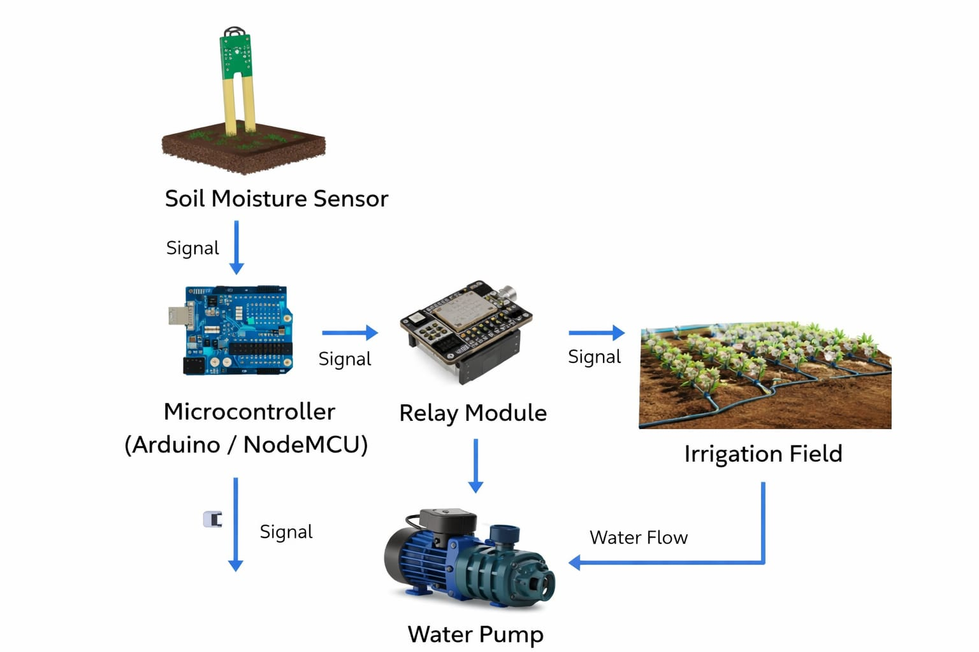
ARCHITECTURE
Sensor → Microcontroller → Relay → Water Pump → Irrigation Field

Slide 11
MODULES
Soil Moisture Detection Module
Microcontroller Processing Module
Pump Control Module
IoT Monitoring Module

Slide 12
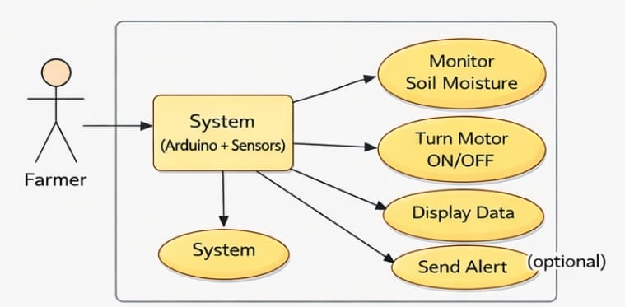
UML - Use Case Diagram
Actors: Farmer
Functions: Monitor soil moisture, Control irrigation pump, View status

Slide 13
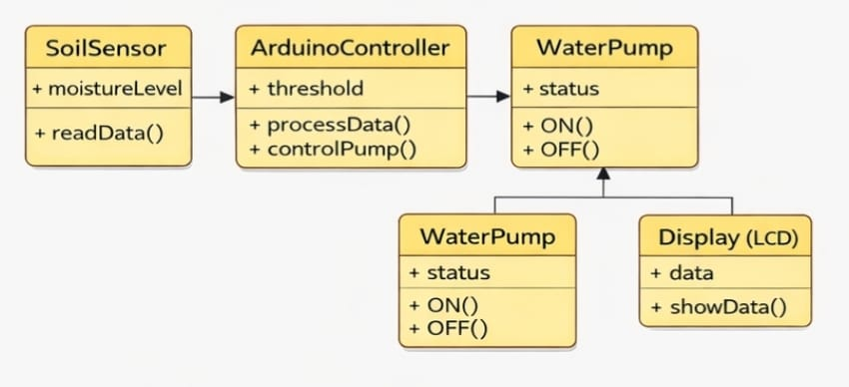
UML - Class Diagram
Classes: Sensor, Microcontroller, Pump, Farmer, Irrigation System

Slide 14
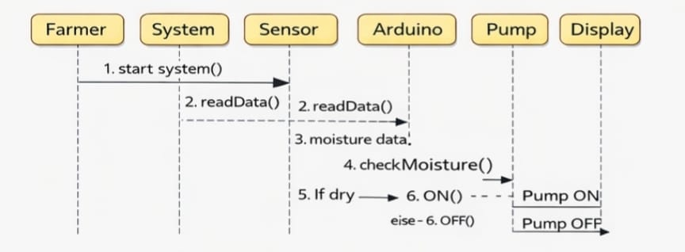
UML - Sequence Diagram
Sequence:-
Sensor reads soil → Microcontroller processes → Pump ON/OFF → Farmer monitors

Slide 15
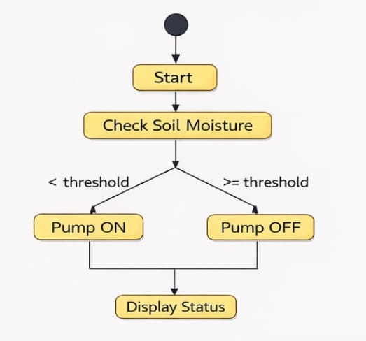
UML - Activity Diagram
Start → Read Soil Moisture → Moisture Low? → YES: Turn Pump ON → NO: Pump OFF → Repeat

Slide 16
Source code:
#include <LiquidCrystal.h>
#include <stdio.h>
LiquidCrystal lcd(6, 7, 5, 4, 3, 2);
// defines pins numbers
//New GPS GY-GPS6MV2
int mos = 8;
int pump = 9;
int buzzer = 13;
int tempc=0;
int hbtc=0,hbtc1=0,rtrl=0,rtr2=0;
int temps=0,hums=0,alcs=0,eyes=0,buttons=0;
unsigned char rcv,count,gchr='x',gchr1='x',robos='s';
char rcvmsg[10],pastnumber[11];
char gpsval[50];
// char dataread[100] = "";
// char lt[15],ln[15];

Slide 17
int i=0,k=0,lop=0;
int gps_status=0;
float latitude=0;
float logitude=0;
String Speed="";
String gpsString="";
char *test="$GPRMC";
//int hbtc=0,hbtc1=0,rtrl=0;
unsigned char gv=0,msg1[10],msg2[11];
float lati=0,longi=0;
unsigned int lati1=0,longi1=0;
unsigned char flat[5],flong[5];
unsigned char finallat[8],finallong[9];
int ii=0,rchkr=0;
String inputString = ""; // a string to hold incoming data
boolean stringComplete = false; // whether the string is complete

Slide 18
void okcheck()
{
unsigned char rcr;
do{
rcr = Serial.read();
} while(rcr != 'K');
}
void sound() {
digitalWrite(buzzer,LOW);delay(1500);digitalWrite(buzzer,HIGH);
}
void setup()
{
// unsigned char rcr;
Serial.begin(9600);//serialEvent();
pinMode(mos, INPUT);pinMode(pump, OUTPUT);
pinMode(buzzer, OUTPUT);
digitalWrite(pump, LOW);digitalWrite(buzzer, HIGH);

Slide 19
lcd.begin(16, 2);lcd.cursor();
lcd.print("Aut Irrigation");
lcd.setCursor(0,1);
lcd.print("Soil Mos Ctrl");
delay(2500);
lcd.clear();
lcd.setCursor(0,0);
lcd.print("Mos:"); //4,0
}
void loop()
{
if(digitalRead(mos) == LOW)
{
lcd.setCursor(4,0);lcd.print("Wet_Pump_OFF");
digitalWrite(pump, LOW);
}

Slide 20
if(digitalRead(mos) == HIGH)
{
lcd.setCursor(4,0);lcd.print("Dry_Pump_ON ");
digitalWrite(pump, HIGH);
}
delay(800);
}

Slide 21
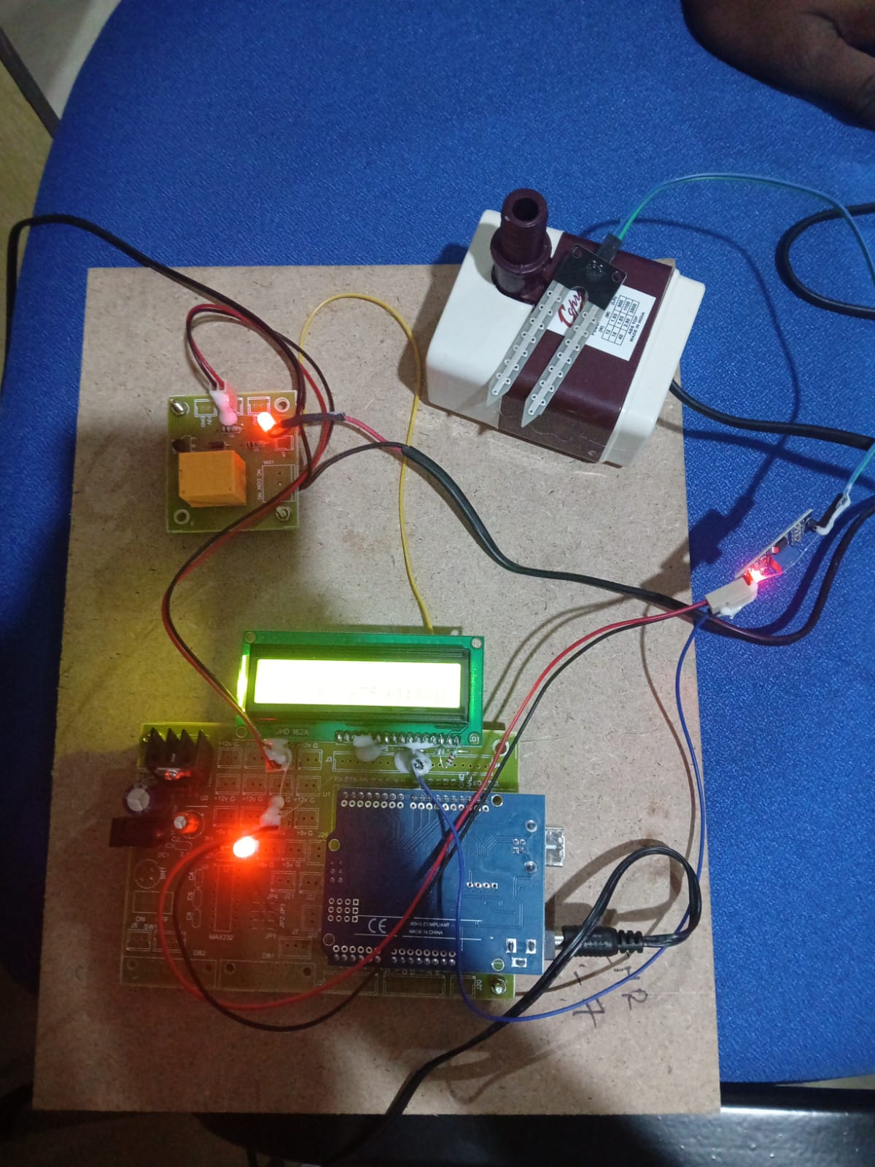
Results:

Slide 22
CONCLUSION
The automatic irrigation system is an effective solution for modern farming. It uses soil moisture to control watering of plants. The system works automatically without human intervention. It ensures that plants get the right amount of water. This improves crop yield. It helps in saving water resources. It also reduces the workload of farmers. It is suitable for farms, gardens, and greenhouses. It can be further improved using advanced technologies. Overall, it is a smart and efficient irrigation method. It supports sustainable agriculture. It is a useful project for real-time applications.

Slide 23
Future Enhancement:
Mobile App Integration
IOT Support
Weather Forecast Integration
AI & Machine Learning
Solar power System
Crop-specific Automation

Slide 24
References:
Romero, R. et al., Research on automatic irrigation control: State of the art and recent developments, Agricultural Water Management
Nagalingam, R., Automatic monitoring of soil moisture and irrigation control, Current Agriculture Research Journal — combined moisture sensing and automatic irrigation operation.
Pramanik, M., Khanna, M., Singh, M., et al., Automation of soil moisture sensor-based basin irrigation system, Advanced Technology (2021) — IoT and sensor network for automatic soil moisture irrigation.

Slide 25
Github link
https://github.com/Manojkumar128/Automated-control-system-for-air-pollution-detection-in-vehicles.git

